Slide 1
Creating real world User Interfaces with Xamarin.Forms
Notes:
Welcome everyone to C# Corner Annual conference.

Slide 2

Who’s this guy?
Harikrishnan
Product Lead – Syncfusion Inc.
harikrishnann@syncfusion.com
https://www.syncfusion.com/products/xamarin
Notes:
How many people are brand new to Xamarin?
How many people are doing thing for a while?

Slide 3

Agenda
Quick overview of Xamarin
Crafting real world applications with Xamarin
Creating real world UI with Syncfusion components
A demo application

Slide 4

Notes:
Xamarin Forms is super awesome and packed with amazing content that we are gonna help you get through via slide docs & some demos.

Slide 5

Write Once, Run Anywhere
Notes:
Xamarin enables you to build shared C# mobile backend of your business objects of apps, such as Model, ViewModel, Rest Service, SQL databases in .NET code that can run everywhere.
Want beautiful UI & access to all Native APIs.
It helps you overcome - Different language, IDE, development environment, tools, Multiple Teams, Multiple Code Bases
You can overcome - Expensive & Slow development

Slide 6
Architecting Mobile Apps
Notes:
Xamarin Platform is usually what you hear about which is building native iOS, Android, Mac, and Windows Apps all in C#
Xamarin offers a wide range of products for developers to go mobile including Test Cloud, Hockey App, and a way to learn all of mobile with University.
So we know what we want.
How do we get there?
Let’s talk about the state of mobile development.

Slide 7
Xamarin’s Unique Approach
iOS C# UI
Android C# UI
Windows C# UI
Shared C# Mobile
Shared C# codebase • 100% native API access • High performance
Notes:
Xamarin does not cross compile.
Own compiler, linker & optimizer for both Android & iOS to go through their own passes to surely build a native assembly at the EOD.
Develop Android, iOS apps using C# at same time. Gives all tools to build & compile everything inside VS.
Craft a beautiful UI for iOS & Android apps inside a VS and access all the native APIs from C#.
You are sharing 50 – 80 % of your codes with 100 % API access.

Slide 8
Xamarin is included in Visual Studio
Xamarin is included
in Visual Studio
Including Community Edition!
Notes:
No additional cost.

Slide 9
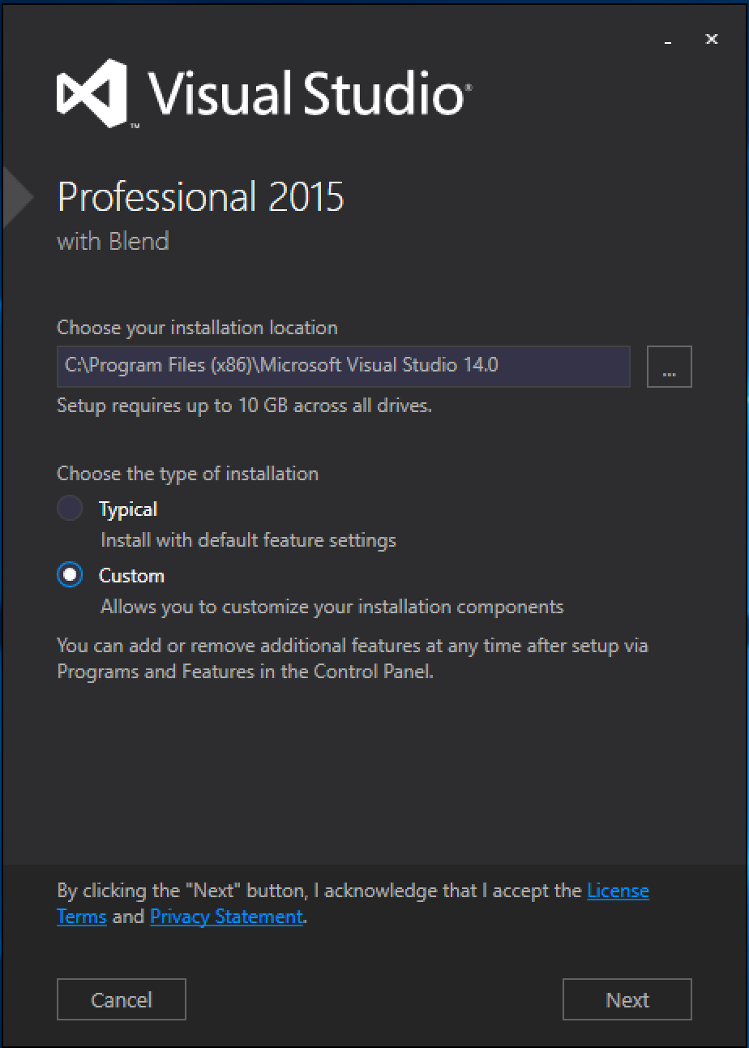
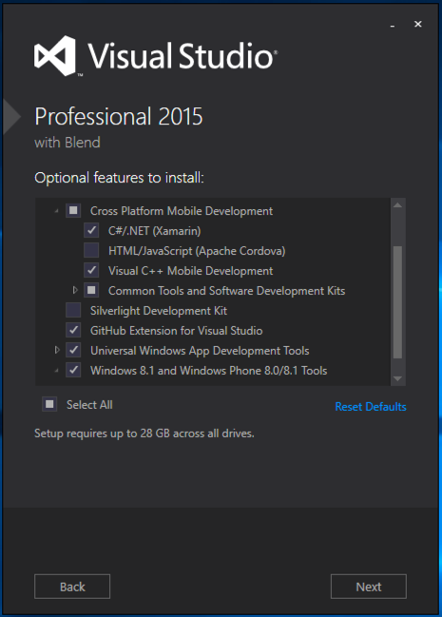
Visual Studio Integration
Xamarin.com/Download
Notes:
Good to go with everything you need inside VS.
If mac, URL – download all the tools you need.

Slide 10
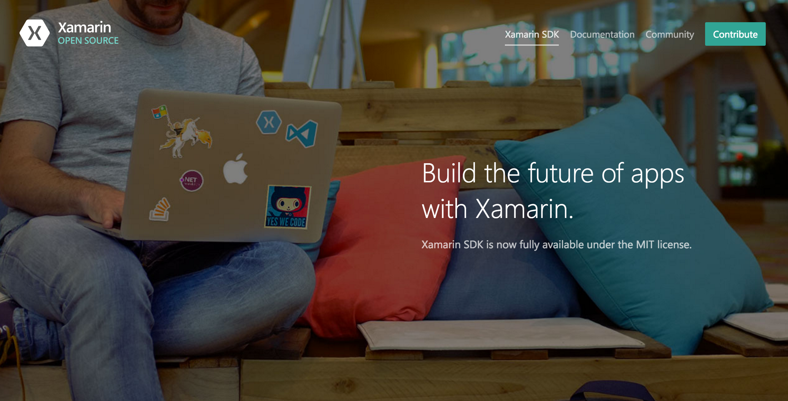
Open Source – open.xamarin.com
Notes:
Xamarin SDKs are completely open source.
Xamarin.iOS, Android, Xforms, components & widgets all these things are open sourced.
Take a look at how they are build up and start contributing to Xamarin.

Slide 11
What’s included
✓ 40+ Pages, layouts, and controls
(Build from code behind or XAML)
✓ Two-way data binding
✓ Navigation
✓ Animation API
✓ Dependency Service
✓ Messaging Center
Shared UI Code
Shared C# Backend

Slide 12

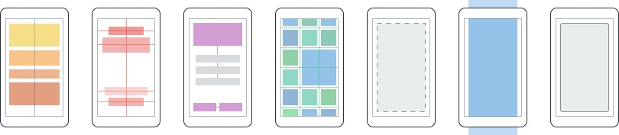
Layouts
Pages
Content
MasterDetail
Navigation
Tabbed
Carousel
Stack
Absolute
Relative
Grid
ContentView
ScrollView
Frame
Notes:
Inside of a page are layouts
A lot of options from something simple like a stack panel to complex and powerful grids

Slide 13
Controls
ActivityIndicator
BoxView
Button
DatePicker
Editor
Entry
Image
Label
ListView
Map
OpenGLView
Picker
ProgressBar
SearchBar
Slider
Stepper
TableView
TimePicker
WebView
EntryCell
ImageCell
SwitchCell
TextCell
ViewCell
Notes:
You have more than 40 controls, layouts, and pages to mix and match from.
These are all of the controls you have out of the box, you can of course create your own.

Slide 14
UITextField
Entry
EditText
TextBox
Notes:
What is unique is you get the native control and have access to it.
Consider an Entry Field
On iOS it is mapped to UITextField
Android it is EditText
UWP it is a TextBox

Slide 15
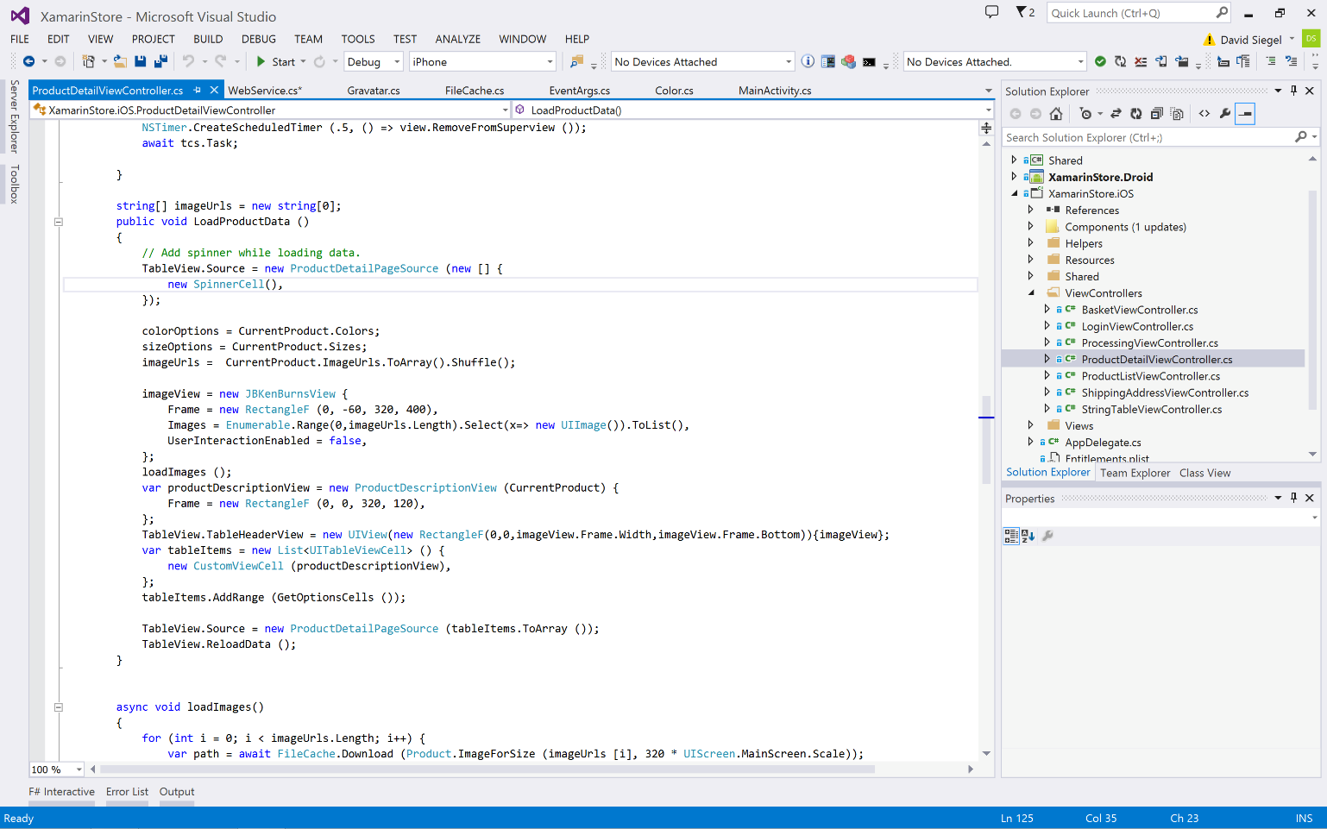
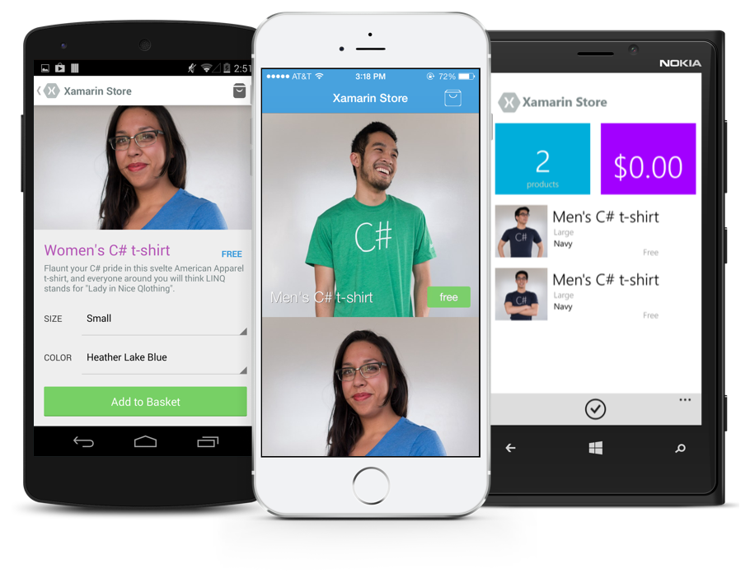
Anything you can do in Objective-C, Swift, or Java can be done in C# and Visual Studio with Xamarin.

Slide 16
Sharing Code
Notes:
How development is on day to day basis?
How actually we can share some code, while building applications?

Slide 17
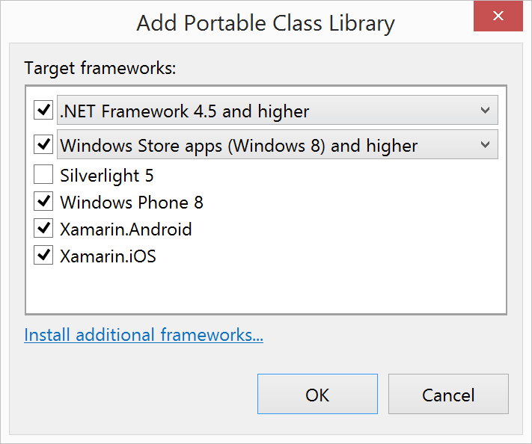
Portable Class Libraries
1 Assembly
Multiple Platforms
Including:
Xamarin.iOS and Xamarin.Android
Notes:
PCL targets different platforms that you wanna support.

Slide 18
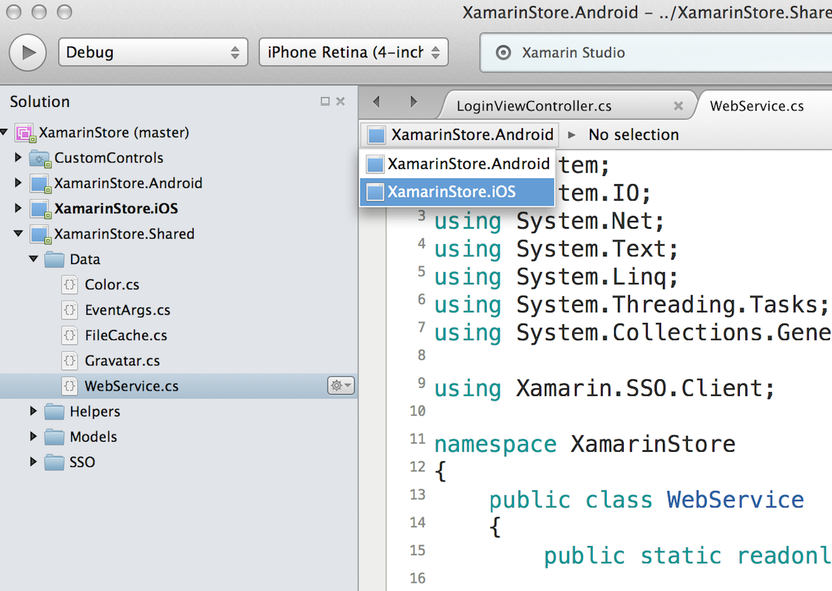
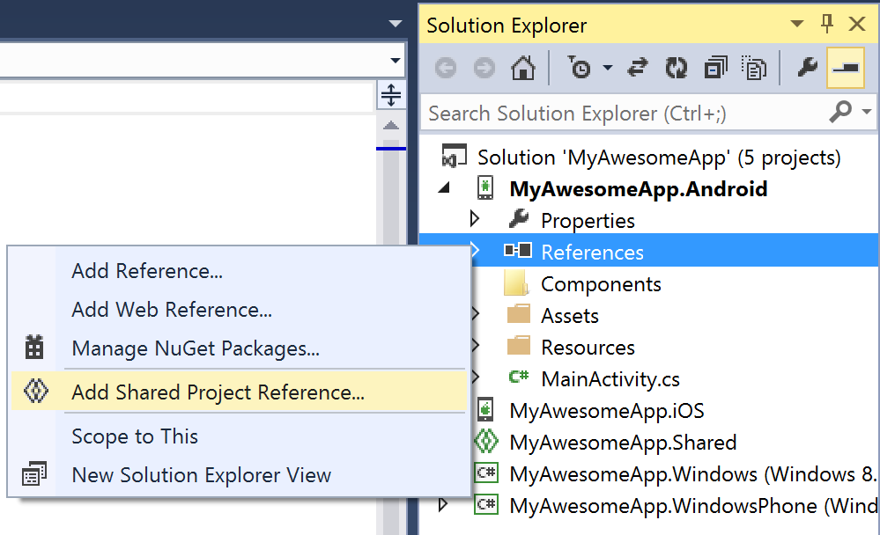
Shared Projects
Notes:
Shared Projects let you write common code that is referenced by a number of different application projects.
The code is compiled as part of each referencing project and can include compiler directives to help incorporate platform-specific functionality into the shared code base.
Things in iOS, Android & WP that I can write against. I just wanna write some code files & I wanna share & link them in – Shared project just do that.
No Assembly, References. Its just code files that automatically get added in each other sub projects.

Slide 19
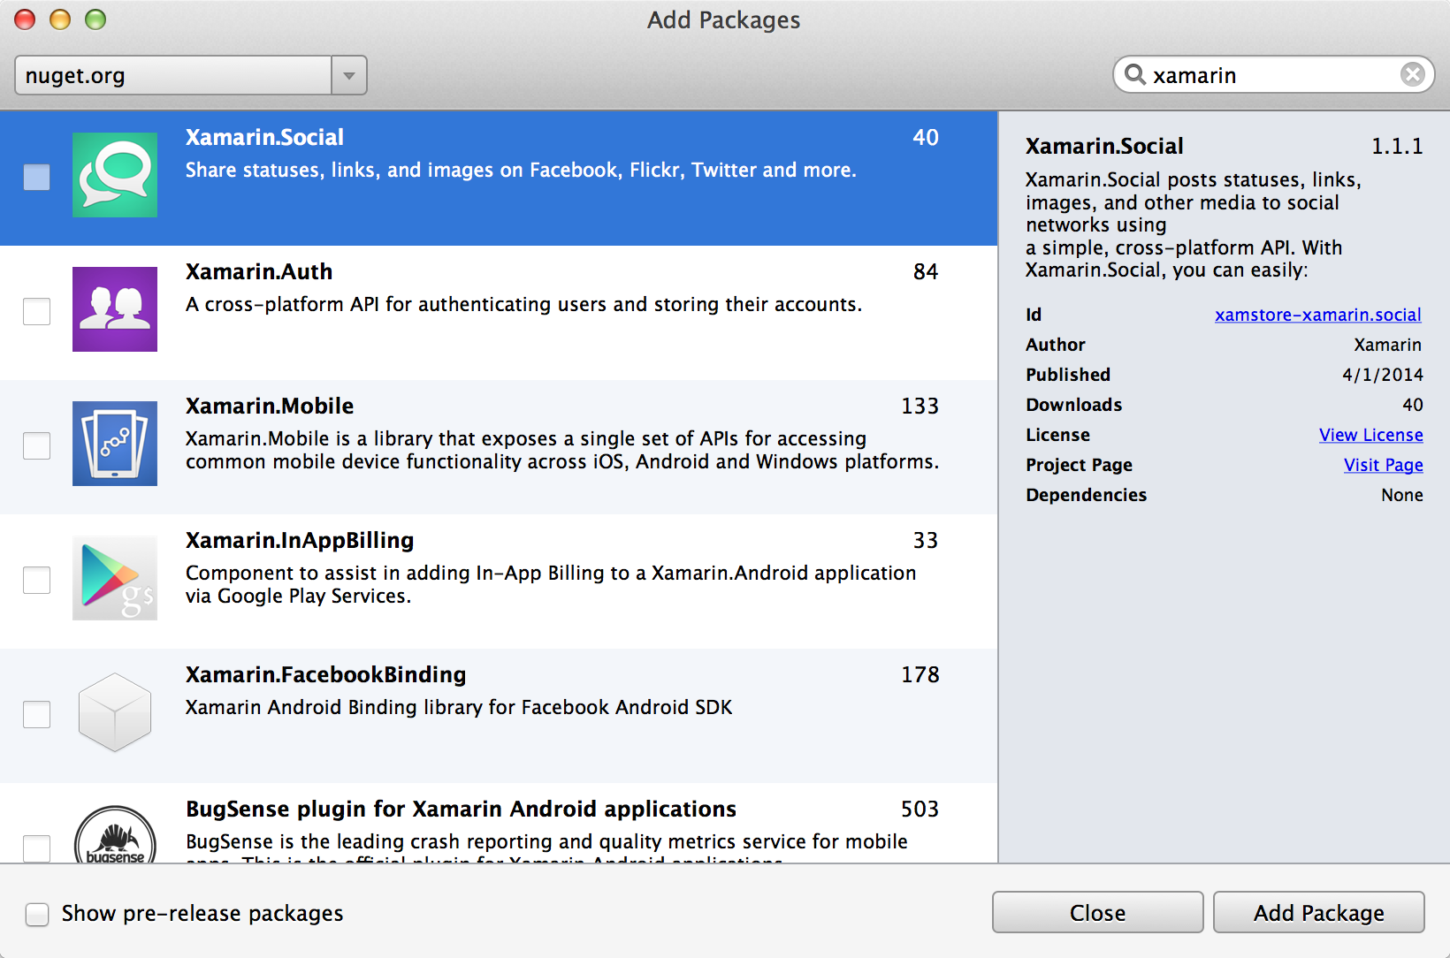
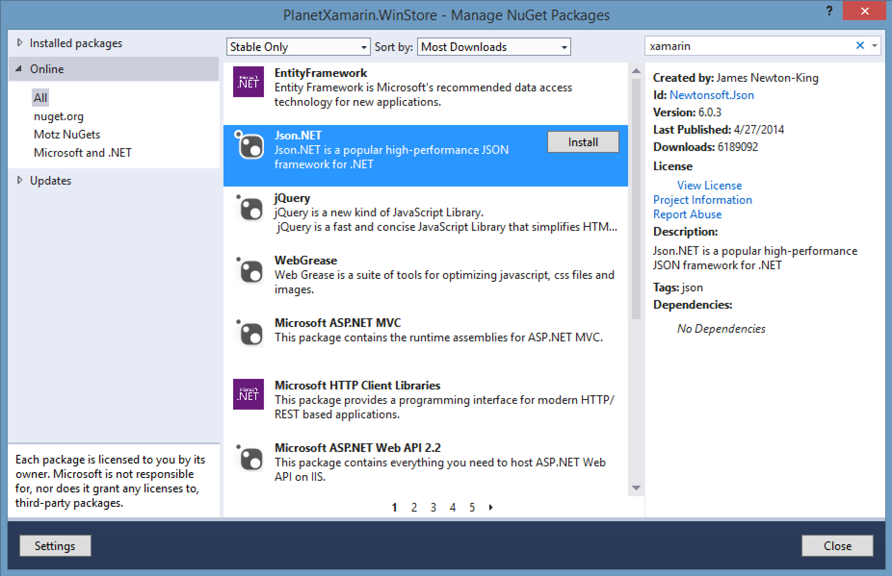
NuGet
Notes:
Things are really great with NuGets.
You can create Libraries, PCL – you come back in and distribute them.

Slide 20
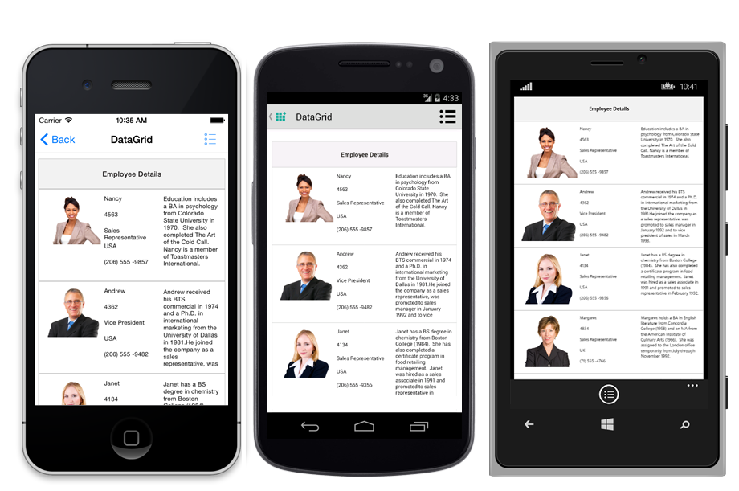
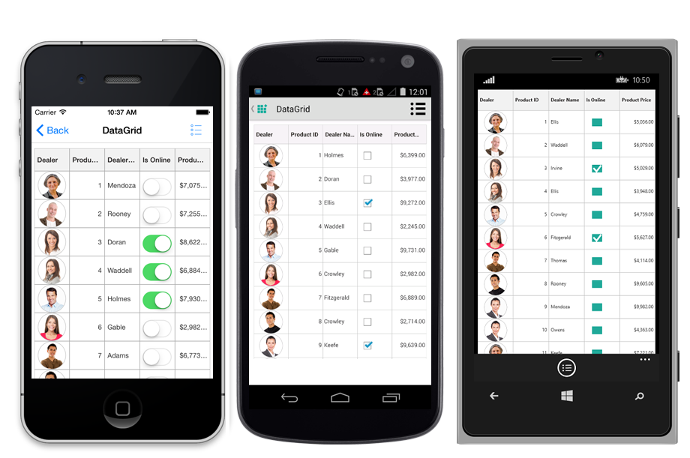
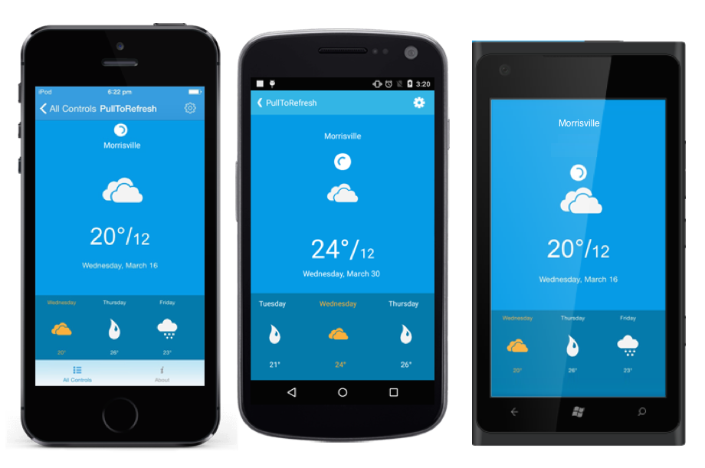
Creating real world UI with Syncfusion components
Stunning data visualization and data bound components
Unique Excel, Word, and PDF manipulations
Full Xamarin.Forms Support
iOS, Android, and Windows
C# or XAML
Data Binding Support
Notes:
Develop custom components using Xamarin.
92+ control in Xamarin
Our components target Xamarin.Android, Xamarin.iOS & Xamarin.Forms

Slide 21
Let’s Build an App

Slide 22
Demo - https://github.com/syncfusion/Xamarin-ExpenseAnalysis
SQLite for Universal Windows Platform
https://marketplace.visualstudio.com/items?itemName=SQLiteDevelopmentTeam.SQLiteforUniversalWindowsPlatform

Slide 23
Thank you ☺
Harikrishnan
Syncfusion Inc.
harikrishnann@syncfusion.com nharishkrish@gmail.com
https://www.syncfusion.com/products/xamarin/datagrid
https://www.linkedin.com/in/hari-krishnan-304a0272

